Slide 1
Applied Cryptography Lagrange’s theorem, Fermat test, Miller-Rabin test
Liangfeng Zhang
School of Information Science and Technology
ShanghaiTech University

Slide 2
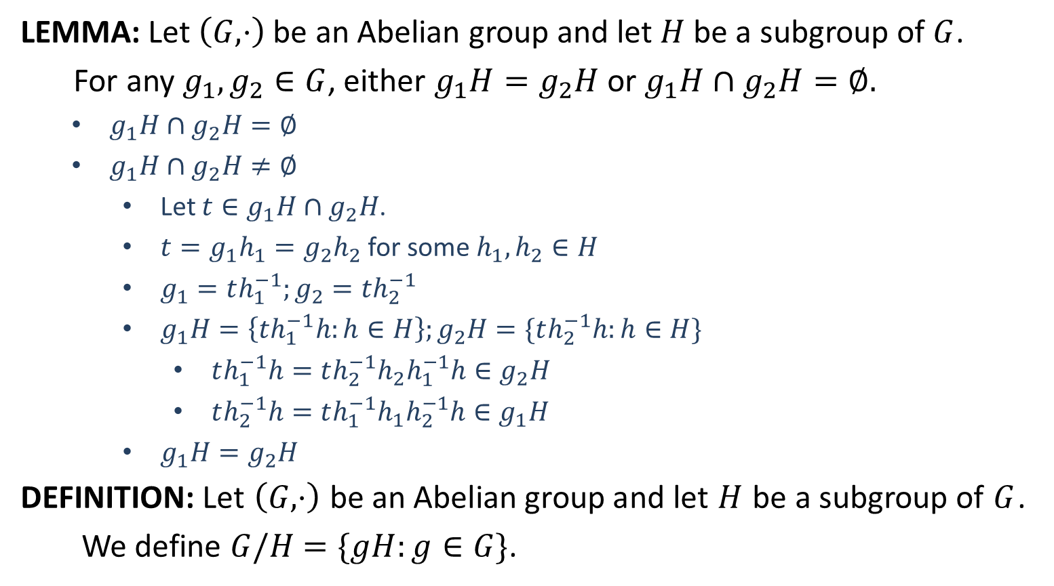
Coset
LEMMA: Let $\left(G,⋅\right)$ be an Abelian group and let $H$ be a subgroup of $G$.
For any $g_{1},g_{2}∈G$, either $g_{1}H=g_{2}H$ or $g_{1}H∩g_{2}H=∅.$
$g_{1}H∩g_{2}H=∅$
$g_{1}H∩g_{2}H≠∅$
Let $t∈g_{1}H∩g_{2}H$.
$t=g_{1}h_{1}=g_{2}h_{2}$ for some $h_{1},h_{2}∈H$
$g_{1}=th_{1}^{−1};g_{2}=th_{2}^{−1}$
$g_{1}H=\left\{th_{1}^{−1}h:h∈H\right\};g_{2}H=\{th_{2}^{−1}h:h∈H\}$
$th_{1}^{−1}h=th_{2}^{−1}h_{2}h_{1}^{−1}h∈g_{2}H$
$th_{2}^{−1}h=th_{1}^{−1}h_{1}h_{2}^{−1}h∈g_{1}H$
$g_{1}H=g_{2}H$
DEFINITION: Let $\left(G,⋅\right)$ be an Abelian group and let $H$ be a subgroup of $G$.
We define $G/H$ $=\{gH:g∈G\}$.

Slide 3
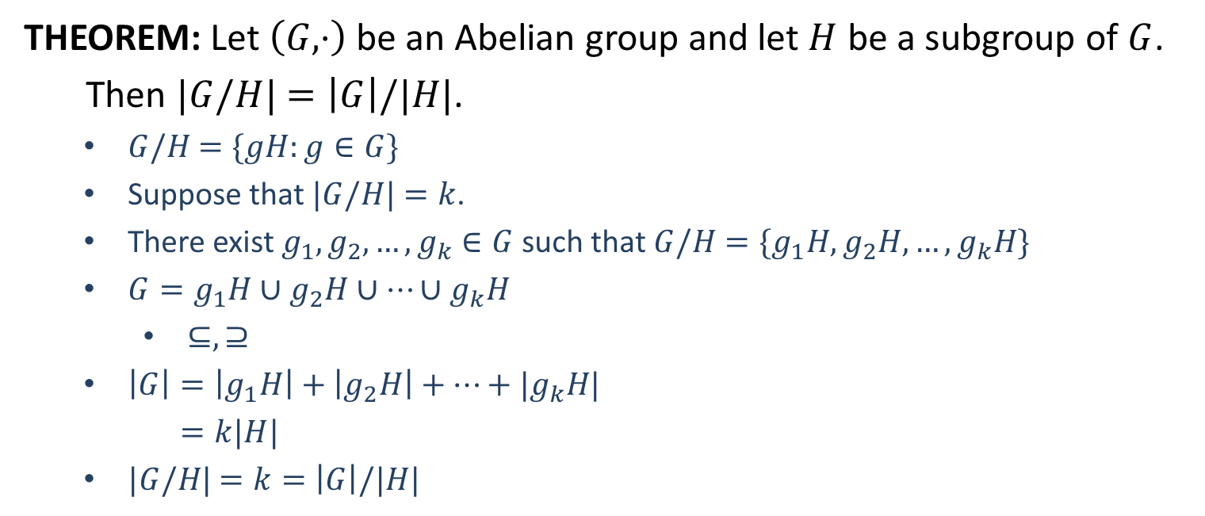
Lagrange’s Theorem
THEOREM: Let $\left(G,⋅\right)$ be an Abelian group and let $H$ be a subgroup of $G$.
Then $|G/H|$ $=\left|G\right|/|H|$.
$G/H$ $=\{gH:g∈G\}$
Suppose that $|G/H|$ $=k$.
There exist $g_{1},g_{2},…,g_{k}∈G$ such that $G/H$ $=\{g_{1}H,g_{2}H, …,g_{k}H\}$
$G=g_{1}H∪g_{2}H∪⋯∪g_{k}H$
$⊆, ⊇$
$\left|G\right|=\left|g_{1}H\right|+\left|g_{2}H\right|+⋯+|g_{k}H|$
$=k|H|$
$|G/H|$ $=k=\left|G\right|/|H|$

Slide 5
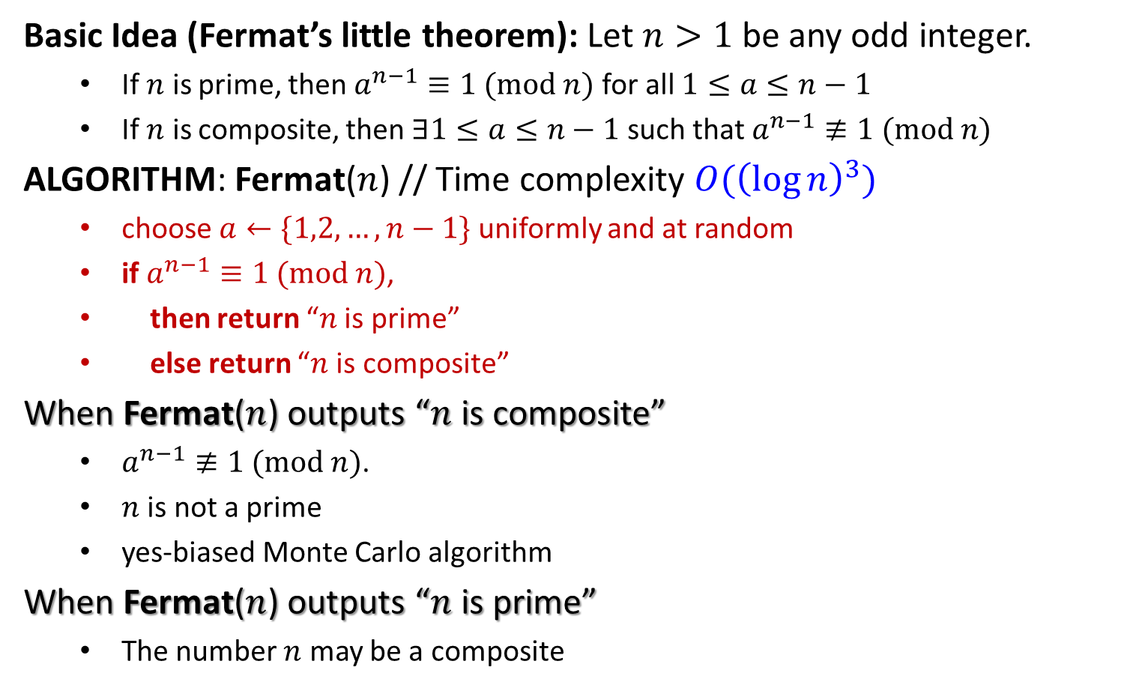


Fermat Test
Basic Idea (Fermat’s little theorem): Let $n>1$ be any odd integer.
If $n$ is prime, then $a^{n−1}≡1 (mod n)$ for all $1≤a≤n−1$
If $n$ is composite, then $∃1≤a≤n−1$ such that $a^{n−1}≢1 (mod n)$
ALGORITHM: Fermat($n$) // Time complexity $O({\left(\log{n}\right)}^{3})$
choose $a←\{1,2,…,n−1\}$ uniformly and at random
if $a^{n−1}≡1 (mod n)$,
then return “$n$ is prime”
else return “$n$ is composite”
When Fermat($n$) outputs “$n$ is composite”
$a^{n−1}≢1 (mod n)$.
$n$ is not a prime
yes-biased Monte Carlo algorithm
When Fermat($n$) outputs “$n$ is prime”
The number $n$ may be a composite
When $n=561,$ $4/7$ out of the
integers $a∈\{1,2,…,n−1\}$
satisfy $a^{n−1}≡1(mod n)$
$ε=4/7$!
very large error probability!
Carmichael Number $n$:
$a^{n−1}≡1 (mod n)$ when $gcd\left(a,n\right)=1$
There are $∞$ such numbers
//$n$ is a composite
Solution ???

Slide 6
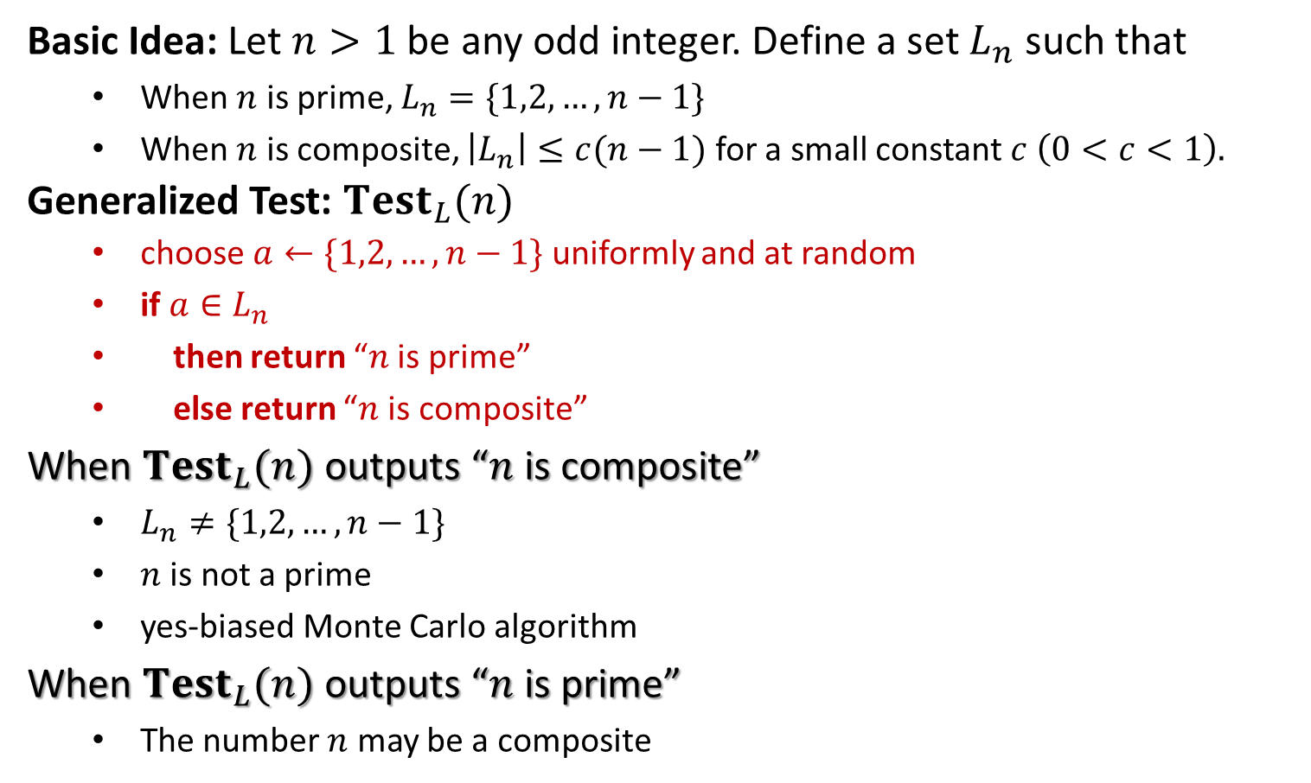
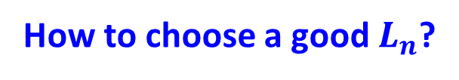
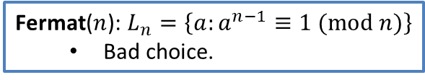
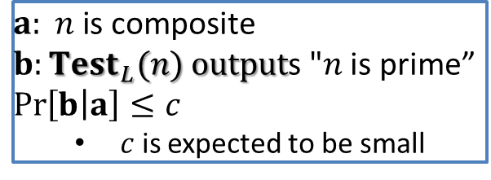

Generalization
Basic Idea: Let $n>1$ be any odd integer. Define a set $L_{n}$ such that
When $n$ is prime, $L_{n}=\{1,2,…,n−1\}$
When $n$ is composite, $\left|L_{n}\right|≤c(n−1)$ for a small constant $c \left(0<c<1\right).$
Generalized Test: $Test_{L}(n)$
choose $a←\{1,2,…,n−1\}$ uniformly and at random
if $a∈L_{n}$
then return “$n$ is prime”
else return “$n$ is composite”
When $Test_{L}(n)$ outputs “$n$ is composite”
$L_{n}≠\{1,2,…,n−1\}$
$n$ is not a prime
yes-biased Monte Carlo algorithm
When $Test_{L}(n)$ outputs “$n$ is prime”
The number $n$ may be a composite
$$a: n \text{is} \text{composite}$$
$$b:Test_{L}(n) \text{output}\text{s}\text{ "}n \text{is} \text{prime}\text{”}$$
$$\operatorname{Pr}\left[b | a\right]≤c$$
$c$ is expected to be small
Fermat($n$): $L_{n}=\left\{a:a^{n−1}≡1 (mod n)\right\}$
Bad choice.
//$n$ is a composite
How to choose a good $L_{n}$?

Slide 7
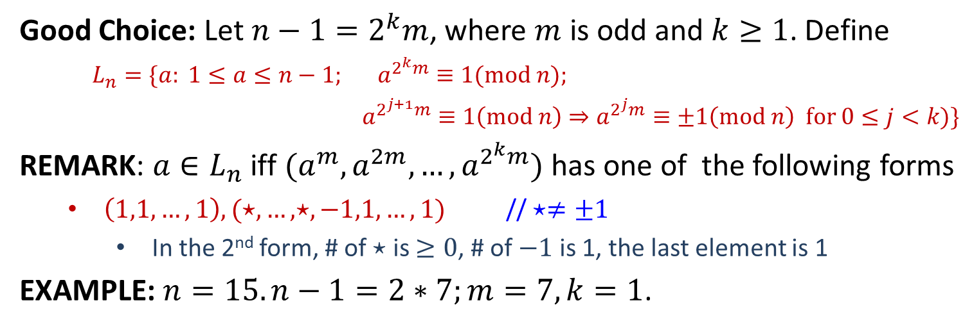
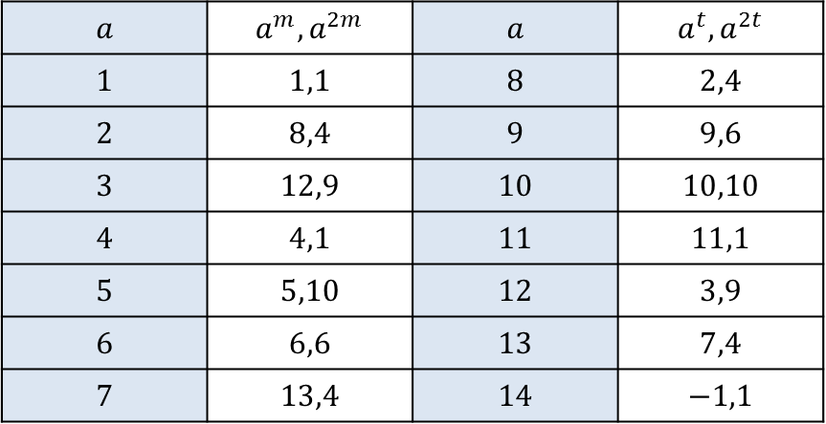
Miller-Rabin Test
Good Choice: Let $n−1=2^{k}m$, where $m$ is odd and $k≥1$. Define
$L_{n}=\{a: 1≤a≤n−1; a^{2^{k}m}≡1(mod n);$
$a^{2^{j+1}m}≡1\left(mod n\right)⇒a^{2^{j}m}≡±1\left(mod n\right) for 0≤j<k)\}$
REMARK: $a∈L_{n}$ iff $(a^{m}, a^{2m}, …,a^{2^{k}m})$ has one of the following forms
$\left(1,1,…,1\right), (⋆,…,⋆,−1,1,…,1)$ // $⋆≠±1$
In the 2nd form, # of $⋆$ is $≥0$, # of $−1$ is 1, the last element is 1
EXAMPLE: $n=15. n−1=2∗7;m=7, k=1$.
$$a$$ | $$a^{m},a^{2m}$$ | $$a$$ | $$a^{t}, a^{2t}$$
$$1$$ | $$1,1$$ | $$8$$ | $$2,4$$
$$2$$ | $$8,4$$ | $$9$$ | $$9,6$$
$$3$$ | $$12,9$$ | $$10$$ | $$10,10$$
$$4$$ | $$4,1$$ | $$11$$ | $$11,1$$
$$5$$ | $$5,10$$ | $$12$$ | $$3,9$$
$$6$$ | $$6,6$$ | $$13$$ | $$7,4$$
$$7$$ | $$13,4$$ | $$14$$ | $$−1,1$$

Slide 8
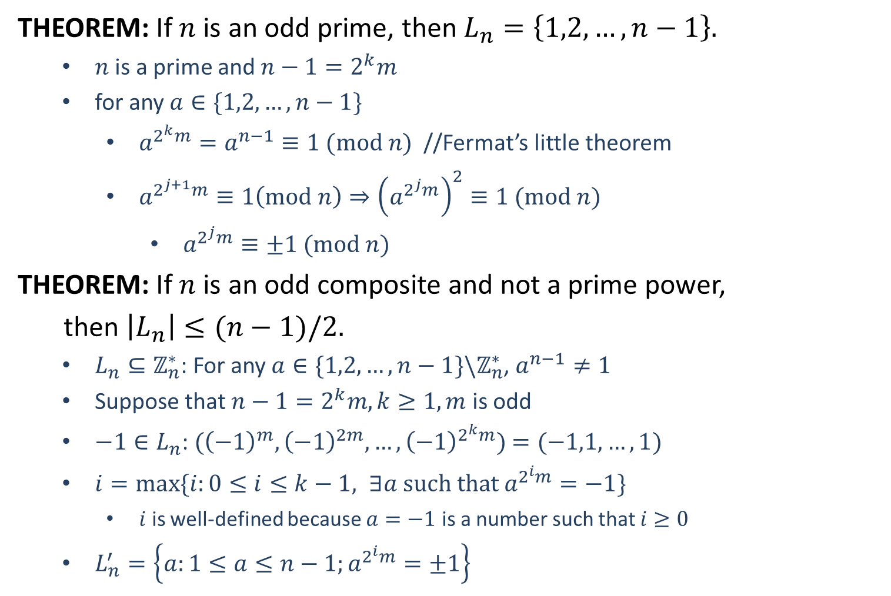
THEOREM: If $n$ is an odd prime, then $L_{n}=\left\{1,2,…,n−1\right\}.$
$n$ is a prime and $n−1=2^{k}m$
for any $a∈\{1,2,…,n−1\}$
$a^{2^{k}m}=a^{n−1}≡1 (mod n)$ //Fermat’s little theorem
$a^{2^{j+1}m}≡1\left(mod n\right)⇒{\left(a^{2^{j}m}\right)}^{2}≡1 (mod n)$
$a^{2^{j}m}≡±1 (mod n)$
THEOREM: If $n$ is an odd composite and not a prime power,
then $\left|L_{n}\right|≤(n−1)/2.$
$L_{n}⊆ℤ_{n}^{∗}$: For any $a∈\{1,2,…,n−1\}\backslash ℤ_{n}^{∗}$, $a^{n−1}≠1$
Suppose that $n−1=2^{k}m, k≥1, m$ is odd
$−1∈L_{n}$: $({\left(−1\right)}^{m},{\left(−1\right)}^{2m},…,{\left(−1\right)}^{2^{k}m})$ $=(−1,1,…,1)$
$i=max\{i:0≤i≤k−1, ∃a such that a^{2^{i}m}=−1\}$
$i$ is well-defined because $a=−1$ is a number such that $i≥0$
$L_{n}^{′}=\left\{a:1≤a≤n−1;a^{2^{i}m}=±1\right\}$

Slide 9
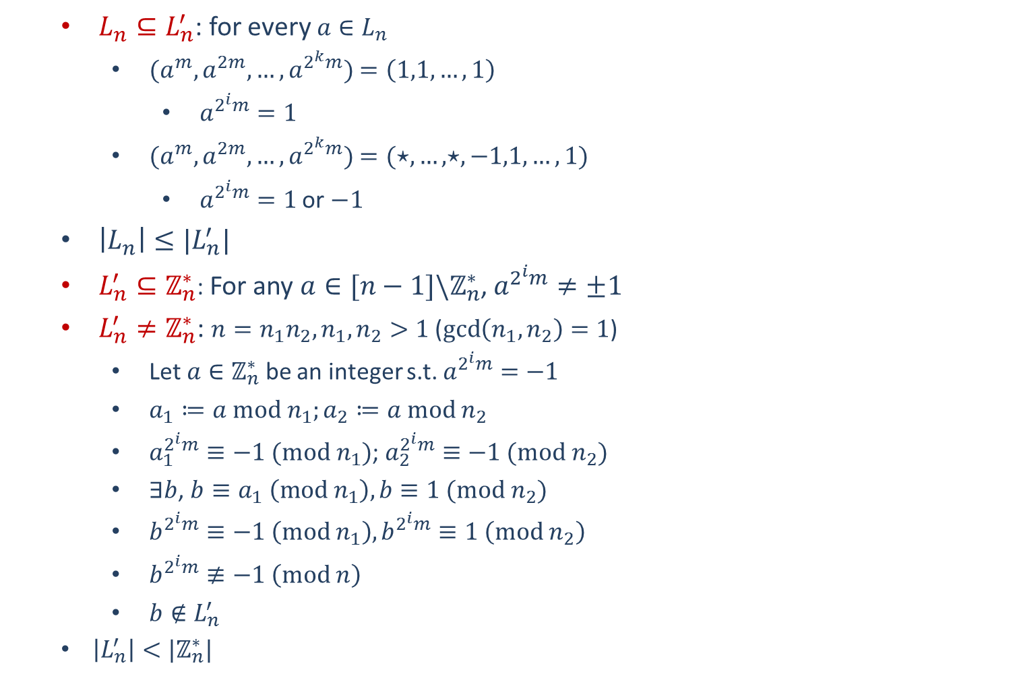

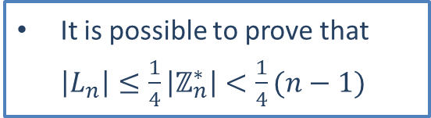

$L_{n}⊆L_{n}^{′}$: for every $a∈L_{n}$
$(a^{m}, a^{2m}, …,a^{2^{k}m})$ $=\left(1,1,…,1\right)$
$a^{2^{i}m}=1$
$(a^{m}, a^{2m}, …,a^{2^{k}m})$ $=(⋆,…,⋆,−1,1,…,1)$
$a^{2^{i}m}=1$ or $−1$
$\left|L_{n}\right|≤|L_{n}^{′}|$
$L_{n}^{′}⊆ℤ_{n}^{∗}$: For any $a∈[n−1]\backslash ℤ_{n}^{∗}$, $a^{2^{i}m}≠±1$
$L_{n}^{′}≠ℤ_{n}^{∗}$: $n=n_{1}n_{2}, n_{1},n_{2}>1$ ($\gcd\left(n_{1},n_{2}\right)=1$)
Let $a∈ℤ_{n}^{∗}$ be an integer s.t. $a^{2^{i}m}=−1$
$a_{1}≔a mod n_{1};a_{2}≔a mod n_{2}$
$a_{1}^{2^{i}m}≡−1 (mod n_{1})$; $a_{2}^{2^{i}m}≡−1 (mod n_{2})$
$∃b$, $b≡a_{1} \left(mod n_{1}\right), b≡1 (mod n_{2})$
$b^{2^{i}m}≡−1 \left(mod n_{1}\right), b^{2^{i}m}≡1 \left(mod n_{2}\right)$
$b^{2^{i}m}≢−1 \left(mod n\right)$
$b∉L_{n}^{′}$
$\left|L_{n}^{′}\right|<|ℤ_{n}^{∗}|$
$L_{n}^{′}≤ℤ_{n}^{∗}$: For any $a,b∈L_{n}^{′}$
$a^{2^{i}m}=b^{2^{i}m}=±1$
${\left(b^{−1}\right)}^{2^{i}m}=±1$
${\left(ab^{−1}\right)}^{2^{i}m}=±1$
$|L_{n}^{′}|$ is a factor of $|ℤ_{n}^{∗}|$
$\left|L_{n}^{′}\right|≤\frac{1}{2}|ℤ_{n}^{∗}|$
$\left|L_{n}\right|≤\frac{1}{2}\left|ℤ_{n}^{∗}\right|<\frac{1}{2}(n−1)$
It is possible to prove that $\left|L_{n}\right|≤\frac{1}{4}\left|ℤ_{n}^{∗}\right|<\frac{1}{4}(n−1)$
$n=p^{e}$ is an odd composite but a prime power?
$∃$an efficient algorithm to find $(p,e)$
Binary search

